Slide 1
Testing with Spock and Groovy
Matt Chiogioji
Software Engineer, Blackbird Technology
October 9, 2017

Slide 2
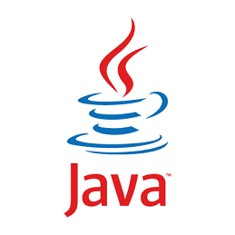

About Me
Software Engineer for ~1.5 years
Member of the Blackbird Technology team
Passion for technology and learning new skills

Slide 3
Agenda
Behavior Driven Development
What is Spock?
Examples
Spock vs JUnit
Demo
Q & A

Slide 4
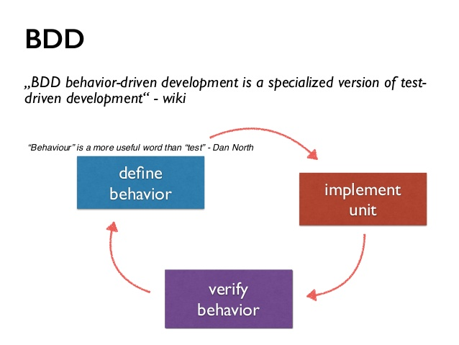
BDD vs TDD
BDD
Emerged from TDD
Enhances collaboration through shared understanding
Specifications over tests
Notes:
TDD is an approach to development where you write a test before you write just enough production code to fulfill that test and then you refactor. The goal of TDD is to think through your requirements or design before your write code
Behavior-driven development combines the general techniques and principles of TDD with ideas from Domain Driven Design
BDD is an extension of TDD
BDD is also known as Acceptance Test Driven Development, or ATDD
TDD:
Developers can get bogged down by the granular details of the process
For example: where to start, what to test and what not to test, how much to test in one go, what to call their tests, and how to understand why a test fails
BDD
The aim of BDD is to make us realize the importance of defining behavior rather than testing per se
This is accomplished by using a specific vocabulary to minimize misunderstandings and encourage the collaboration between business analysts, developers, testers, and stakeholders.
Provides software development and management teams with shared tools and a shared process to collaborate on software development.
Ultimately, the goal of BDD is to develop a consistent vocabulary for developers and the business, to help eliminate some of the ambiguity and miscommunication that occur when technical people talk to business people.
So how does this relate to Spock?
Spock can be considered a BDD testing framework because it enables BDD through its domain specific language

Slide 5

What is Spock?
Spock is a testing and specification framework for Java and Groovy applications
Benefits:
Easy to learn
Eliminates waste
Detailed Information
Notes:
Spock is a testing and specification framework for Java and Groovy applications.
What makes it stand out from the crowd is its highly expressive specification language
Spock is written in Groovy, which means that runs on the JVM and lets you test code written in any of the languages the JVM supports.

Slide 6
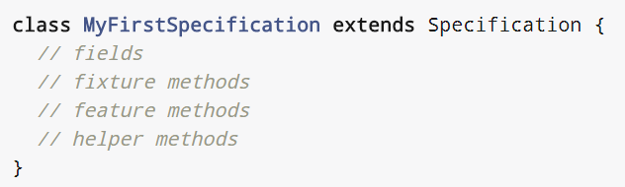
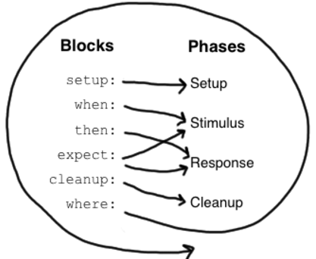
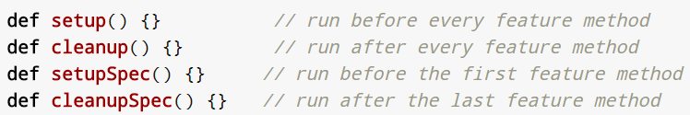
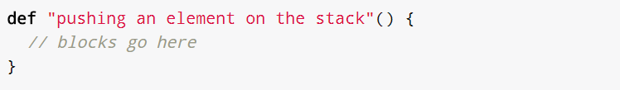
Specification
Notes:
Specification
Spock lets you write specifications that describe expected features (properties, aspects) exhibited by a system of interest. The system of interest could be anything between a single class and a whole application
Fixture Method
Fixture methods are responsible for setting up and cleaning up the environment in which feature methods are run. Usually it’s a good idea to use a fresh fixture for every feature method, which is what the setup() and cleanup() methods are for.
All fixture methods are optional.
Occasionally it makes sense for feature methods to share a fixture, which is achieved by using shared fields together with the setupSpec() and cleanupSpec() methods
Feature Method
Feature methods are the heart of a specification. They describe the features (properties, aspects) that you expect to find in the system under specification. By convention, feature methods are named with String literals.
This is incredibly valuable since it allows the author to explicitly state what he is trying to accomplish and it allows the reader to clearly understand what the goal of the test is
Code is for humans not computers!
Blocks
Spock has built-in support for implementing each of the conceptual phases of a feature method. To this end, feature methods are structured into “blocks”
A feature method must have at least one explicit block
Blocks divide a method into distinct sections, and cannot be nested.
The picture on the right shows how blocks map to the conceptual phases of a feature method.

Slide 7
Code Examples

Slide 8
Spock vs JUnit
Spock
Clear test structure
Built in mocking
Junit
Lacks formal semantics
Need to import a mocking framework
Groovy Power Assert
Hamcrest Matchers
Notes:
Spock
The number one reason, in my opinion, for using Spock is to make your tests more readable.
This may not seem important to you if you are just working on small projects created over the weekend. For big enterprise projects, however test readability is a crucial factor when it comes to working on existing code.
Additionally, Spock’s Given – Then – When makes tests explicit in their actions
Test structure is enforced, so all tests will have the same structure, making it easier to understand after some time.
Spock has a built-in mocking framework so you don’t have to import Mockito or Powermock like in junit.
Additionally, I believe that the Spock mocking framework is easier to use since it is much more expressive and intuitive than Mockito or EasyMock.
Lastly Spock is written in Groovy which means you can take advantage of Groovy’s power assert. Which gives much clearer insight as to why a test fails.
With Hamcrest matchers it is not always clear why a test fails
Junit
Test structure is not enforced which can lead to messy tests that are difficult to follow.
Experienced developers will format and comment tests in a way similar to Spock, however since this is not enforced, it is not always followed
Image sources:
https://www.google.com/imgres?imgurl=https%3A%2F%2Fhabrastorage.org%2Fstorage2%2F9a8%2F94f%2F3cc%2F9a894f3cc2204d959c37766c57cbd806.png&imgrefurl=https%3A%2F%2Fhabrahabr.ru%2Fpost%2F137561%2F&docid=69K-JBpxAGJO5M&tbnid=rS6jeNHPqPd2bM%3A&vet=10ahUKEwi92-uZ-OXWAhXKPiYKHU6EBS4QMwgoKAEwAQ..i&w=250&h=250&safe=off&bih=734&biw=1536&q=spock%20framework&ved=0ahUKEwi92-uZ-OXWAhXKPiYKHU6EBS4QMwgoKAEwAQ&iact=mrc&uact=8
https://www.google.com/imgres?imgurl=http%3A%2F%2Fwww.mkyong.com%2Fwp-content%2Fuploads%2F2016%2F05%2Fjunit-logo.png&imgrefurl=http%3A%2F%2Fwww.mkyong.com%2Ftutorials%2Fjunit-tutorials%2F&docid=L9kaii1XUNlJ3M&tbnid=qrYKQa78QjtNMM%3A&vet=10ahUKEwir7ua4-OXWAhUGeSYKHQ2HAt4QMwg9KAEwAQ..i&w=200&h=200&safe=off&bih=734&biw=1536&q=junit%20logo&ved=0ahUKEwir7ua4-OXWAhUGeSYKHQ2HAt4QMwg9KAEwAQ&iact=mrc&uact=8

Slide 9

Demo
We are going to program a Cashier working for….
https://github.com/mattchiogioji17/spock-demo
Notes:
Image source:
https://www.google.com/imgres?imgurl=https%3A%2F%2Fwww.chick-fil-a-list.com%2FMedia%2FImg%2Fmain%2Fcfa-foot-new.png&imgrefurl=https%3A%2F%2Fwww.chick-fil-a-list.com%2F&docid=cwKPuplfvLbYUM&tbnid=zyK9PRb7eTYc0M%3A&vet=10ahUKEwjd_NGL-OXWAhWKTSYKHXyMDlEQMwhAKAEwAQ..i&w=1306&h=561&safe=off&bih=734&biw=1536&q=chick%20fil%20a%20image&ved=0ahUKEwjd_NGL-OXWAhWKTSYKHXyMDlEQMwhAKAEwAQ&iact=mrc&uact=8

Slide 10
Application Structure

Slide 11

Notes:
Image source: https://www.google.com/url?sa=i&rct=j&q=&esrc=s&source=images&cd=&cad=rja&uact=8&ved=0ahUKEwiLr5yLw_XVAhWo7YMKHYj9BuEQjRwIBw&url=http%3A%2F%2Fkc2rlm.info%2F8174163-any-questions-slide-ppt.html&psig=AFQjCNGVUKNx6r_gKCXdw8fVxGuYNSrBUw&ust=1503858352190403

Slide 12
Sources
Ken Sipe Spock JavaOne 2014
Introduction to Testing with BDD and the Spock Framework
Why Spock
BDD Behavior Driven Development
Why to use Spock

